Slide 1
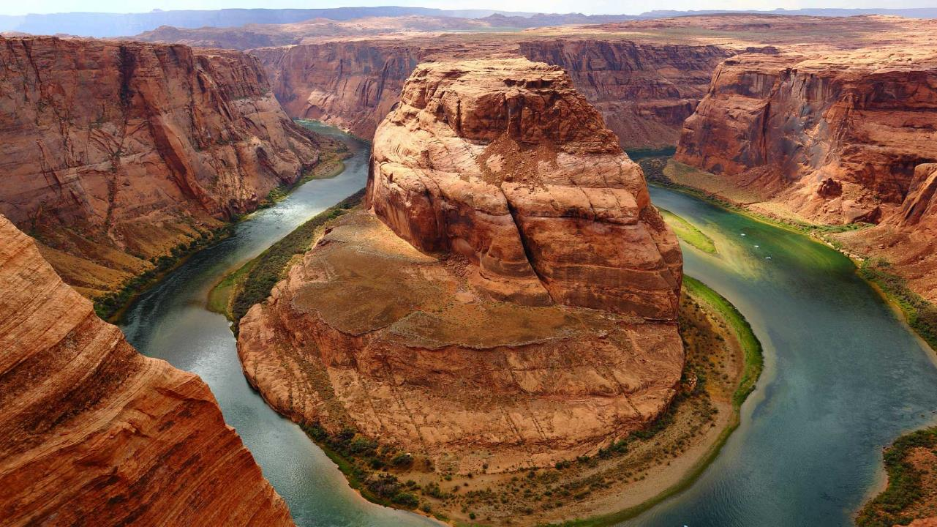
Expedition Stories
N
W
E
S
A Story of your trip by yourself.
Notes:
A template for students to design a field trip to a location for other students to view. Includes directions to the student of what to include on each slide and what content should be considered.

Slide 2
High Level Flow:
Detailed Story
---After Login there will be Dashboard which will have old shared stories of others users if i am 1st time User.
---If i am old user then i will able to see top n publically shared stories after login on full page with having icons at bottom - My Stories, Add Trip, TimeLine.
--- These 3 icons will be same on all screens except login, signup and forget password.
--on click on Add trip pop will open with form having fields -Story Name, Story Type ,trip contact number with button start trip and cancel trip.
--On start button it will navigate to my stories which will photo capture from foursquare api , location category and it will have option to write description, like , share , edit .
--after performing on any these activities data will saved and you can navigate to my stories as this screen will have 3 icons at bottom -My Stories, Add Trip, TimeLine.
--On click on time line it will have a screen with option - searching with story name , as a result of searching one timeline it's details will come in next screen.
-- On Time line page each item will have it's description.
--On click of particular story it will go detailed story page where it will have photo , all likes, description and user can edit photo , text also.
-- In Nav Bar -- My stories , time line , setting , log out will be there .

Slide 3
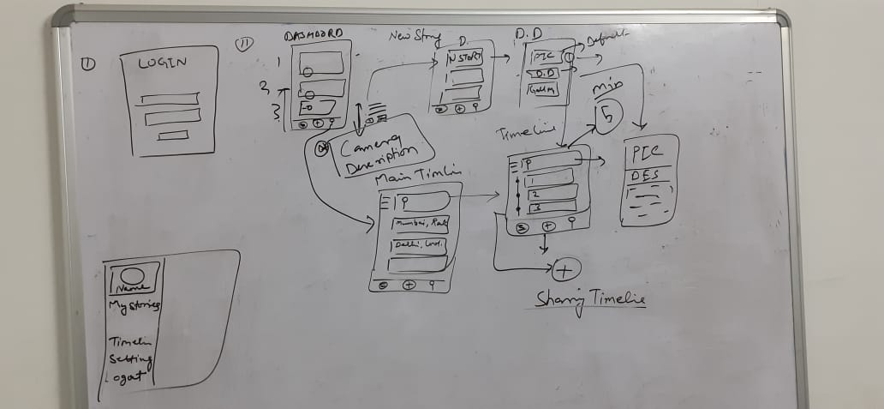
Screen Flow on White Board

Slide 4

DB Schema Details
Find attached DB schema details with data dictionary & table relationship
Notes:
For example, Astoria Oregon is a town on the Oregon coast well know for its starring role in the movie “The Goonies”. Today, we will take a trip from our school to Astoria through miles and time…

Slide 5

Design/Code for Review
Design Link for review : https://invis.io/GDRQHOPYSH5
Solution Design& Other documents Link at GitHub: https://github.com/kindakewlsol/ExpeditionStories

Slide 6

Android & IOS POC files
Find attached Android POC file
For IOS POC file kindly share your Iphone –UDID Number .
How to check your UDID : https://www.wikihow.com/Obtain-the-Identifier-Number-(UDID)-for-an-iPhone,-iPod-or-iPad

Slide 7


Our Team
Design Part : Saifi ,Santosh & Shailender
High Level Design : Sachin & Nishant
Xamarine Developer : Nishnat , Rahul, Mohit, Sheely ,Akshay
API and DB Design: Deepanshu, Dheerendra, Sachin
Project Manager : Sachin
Project Coordinator: Mohit
Server Support : Aryan, Ganga Sagar
Notes:
You can use this type of slide for text, images, shapes and tables to help add information in a different way. Duplicate this slide to add additional images of important location in your visit.

Slide 8

END SLIDE
Thanks

